Slide 1

Ensemble Learning
Hao XU
Yanjie Ren
Daris CHUA
Chih-Tung CHEN
Konstantina TSILIFONI

Slide 2

TABLE OF CONTENTS
1.
2.
Part 1
Part 2
Airbnb price prediction
Building a decision tree from scratch

Slide 3

TABLE OF CONTENTS PART 1
01
02
03
Problem Definition
EDA & Preprocessing
Feature Engineering
04
05
06
Feature Selection
Models & Results
Conclusion
Defining the problem and the motivation
Exploratory data analysis
Describe the topic of the section
Describe the topic of the section
Implemented models and results
Comparison of model performance and conclusions

Slide 4
TABLE OF CONTENTS PART 1
01
02
03
Problem Definition
EDA & Preprocessing
Feature Engineering
04
05
06
Feature Selection
Models & Results
Conclusion
Defining the problem and the motivation
Exploratory data analysis
Generating useful new features
Describe the topic of the section
Implemented models and results
Comparison of model performance and conclusions

Slide 5
PROBLEM DEFINITION
Traditional hotels dominate the accommodation market, but Airbnb is rapidly growing as a major player
The dynamic accommodation market is affected by economic conditions, government policies, and external factors like natural disasters or pandemics
The price of an apartment or a room on Airbnb can be significantly impacted by factors like area, construction quality, location, and amenities, making accurate pricing challenging
Real estate players like developers, investors, and agents rely on accurate pricing models to make informed decisions about pricing strategy
A robust pricing model for Airbnb can benefit both property owners and travelers, ensuring fair prices and informed decisions.

Slide 6
TABLE OF CONTENTS PART 1
01
02
03
Problem Definition
EDA & Preprocessing
Feature Engineering
04
05
06
Feature Selection
Models & Results
Conclusion
Defining the problem and the motivation
Exploratory data analysis
Generating useful new features
Describe the topic of the section
Implemented models and results
Comparison of model performance and conclusions

Slide 7
EXPLORATORY DATA ANALYSIS
Outlier Detection
Detecting price outliers and mapping them
Scaling
Descriptive Statistics
Scaling the data appropriately
Data visualisation
Missing Data Treatment
Creating insightful graphs
Substituting null values with appropriate values

Slide 8
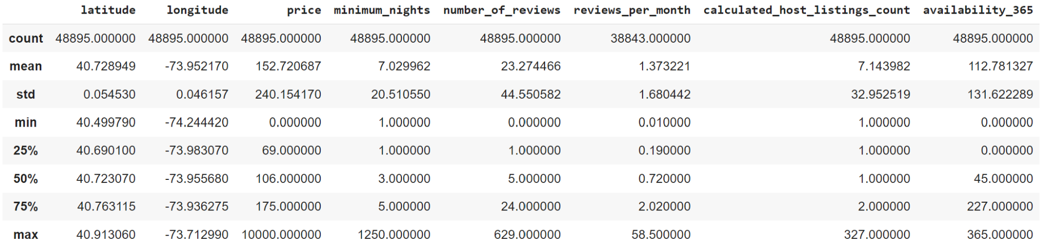
DESCRIPTIVE STATISTICS

Slide 9
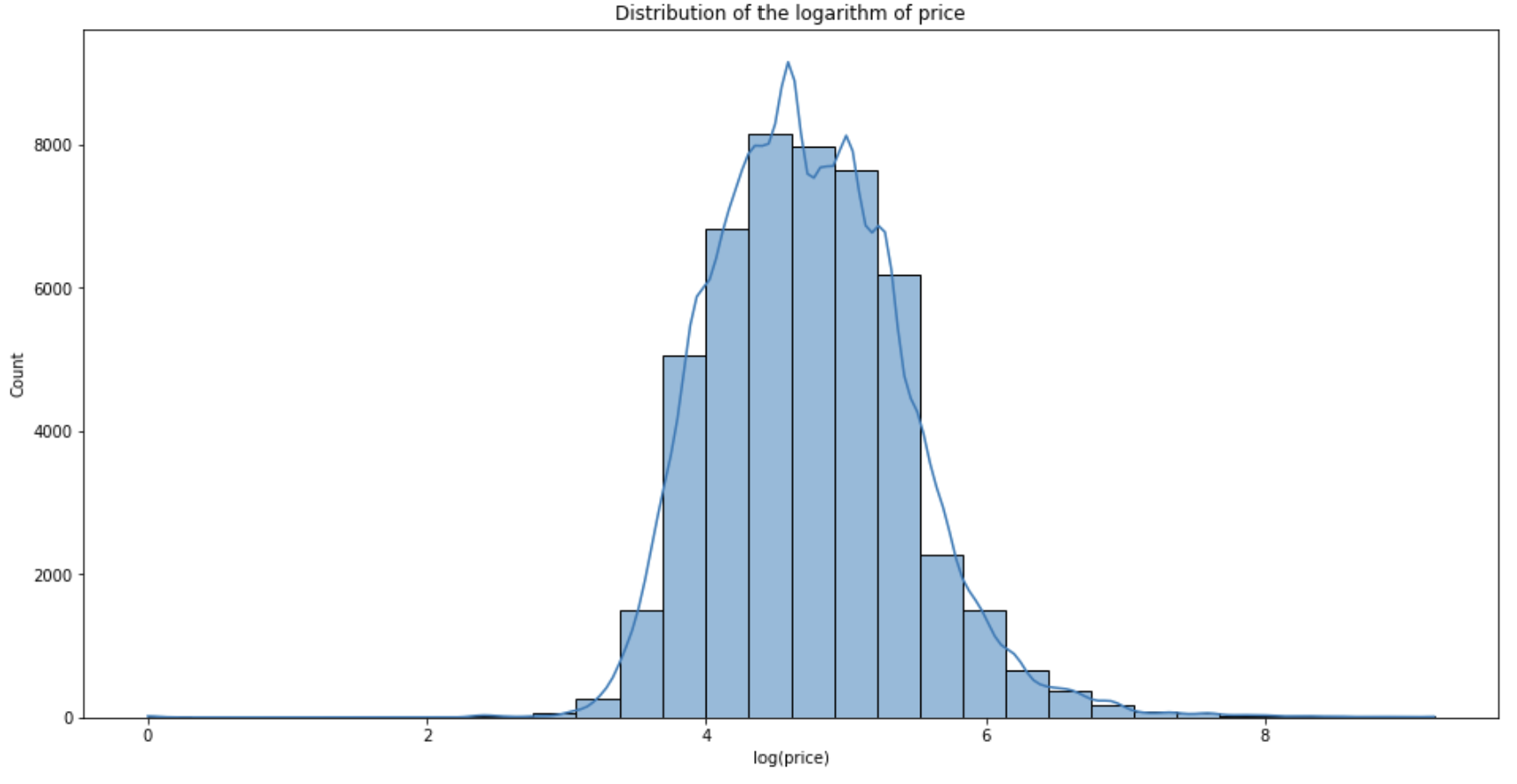
MARKET TRENDS
Log of price follows a normal distribution
Dependant Variable:
log(Price)

Slide 10
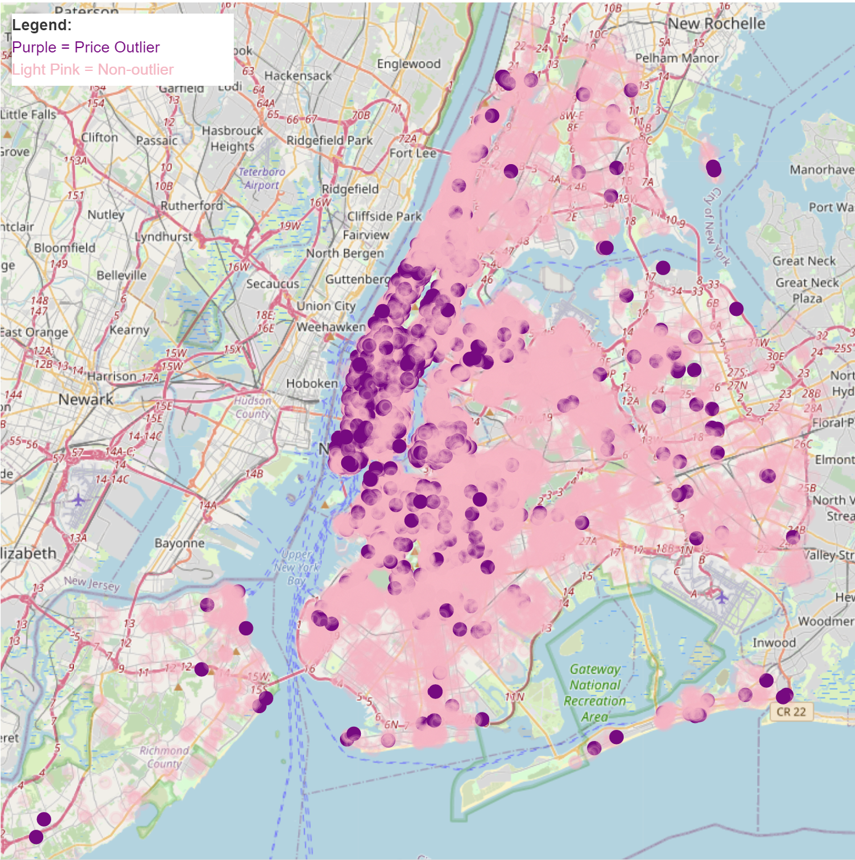
OUTLIER DETECTION
Outlier detection based on Price
Outliers: Purple Points

Slide 11
TABLE OF CONTENTS PART 1
01
02
03
Problem Definition
EDA & Preprocessing
Feature Engineering
04
05
06
Feature Selection
Models & Results
Conclusion
Defining the problem and the motivation
Exploratory data analysis
Generating useful new features
Describe the topic of the section
Implemented models and results
Comparison of model performance and conclusions

Slide 12



FEATURE ENGINEERING
2.
1.
3.
New listing
Features With Time
Adding a new feature of whether the listing is new on the platform
Days since the last review
Months since the listing was added to the platform
Availability
Transforming the “availability_365” to groups

Slide 13
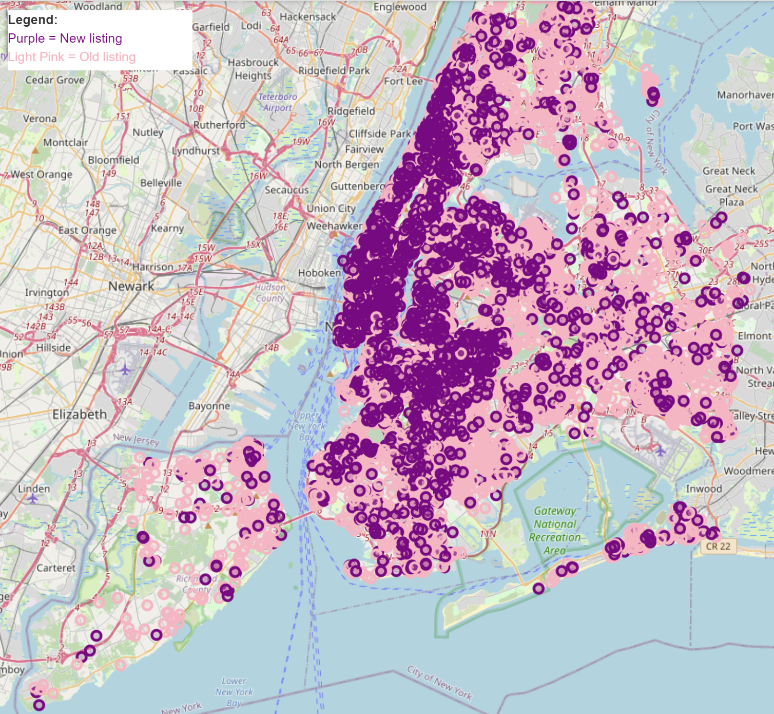
NEW LISTING
192,91
142,31
NEW
OLD

Slide 14
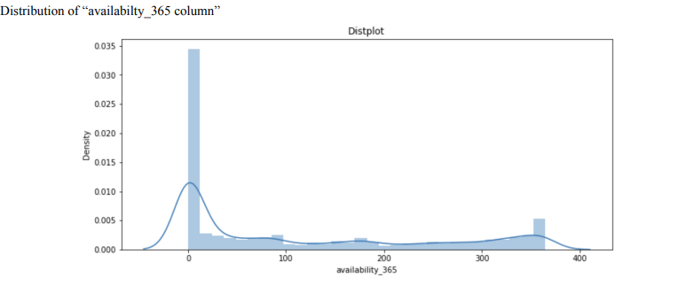
Availabilty_365
All_year_avail: > 350 days a year
Low_avail: < 12 days

Slide 15
New Features with Time
review_recency
months
The number of days since the last review of a listing
The number of months a listing has been on the platform.
Dividing the number of reviews by the reviews per month.

Slide 16
TABLE OF CONTENTS PART 1
01
02
03
Problem Definition
EDA & Preprocessing
Feature Engineering
04
05
06
Feature Selection
Models & Results
Conclusion
Defining the problem and the motivation
Exploratory data analysis
Generating useful new features
Describe the topic of the section
Implemented models and results
Comparison of model performance and conclusions

Slide 17
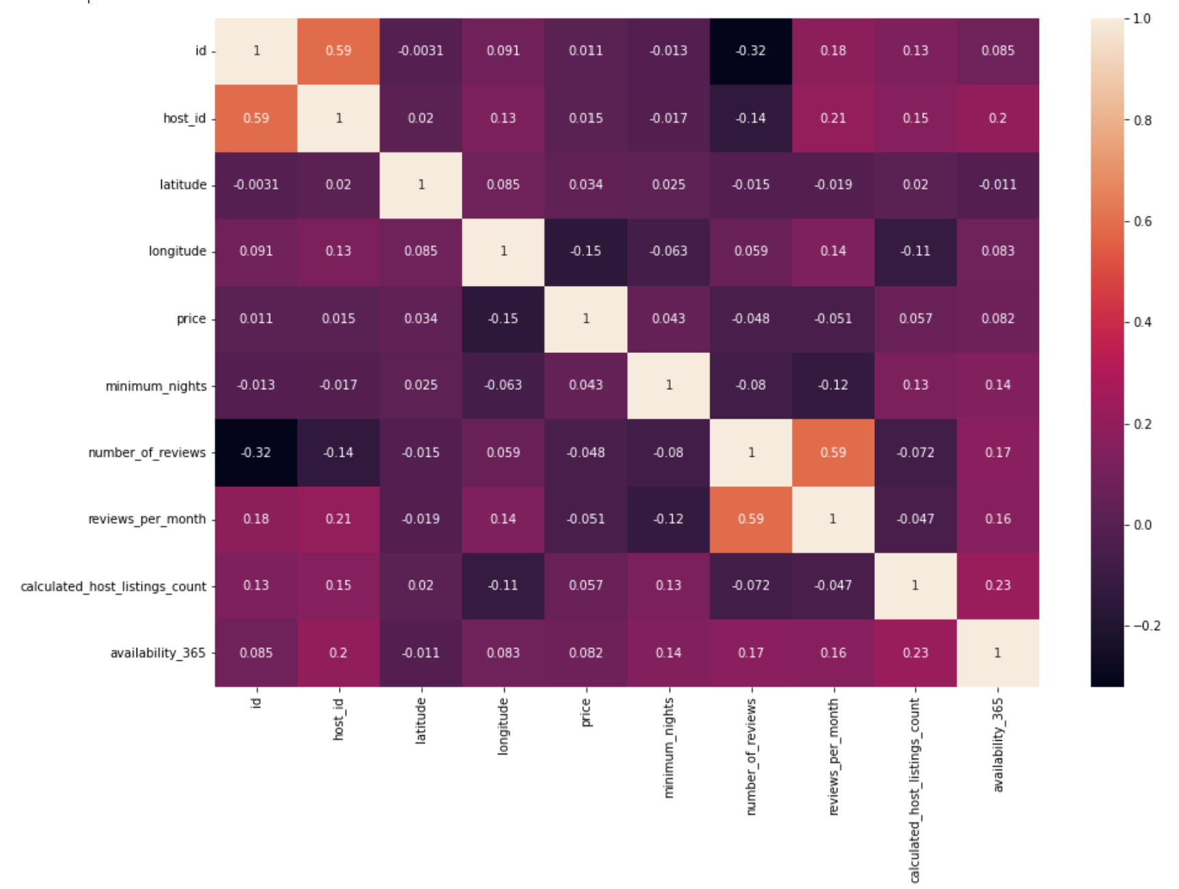
FEATURE SELECTION
Variables we drop:
id, name, host_id, host_name, last_review

Slide 18
TABLE OF CONTENTS PART 1
01
02
03
Problem Definition
EDA & Preprocessing
Feature Engineering
04
05
06
Feature Selection
Models & Results
Conclusion
Defining the problem and the motivation
Exploratory data analysis
Generating useful new features
Describe the topic of the section
Implemented models and results
Comparison of model performance and conclusions

Slide 19
MODELS
Decision Tree
Gradient Boosting
Potential Issue of high variance
Combine weak classifiers
Bagging
XGBoost
Problem of Bagging
Improvement using Boosting
Random Forest
AdaBoost
Why we choose RF
Adaptive to misclassification

Slide 20

1.
Decision Tree

Slide 21
DECISION TREE
Parameter | Grid | Best parameter
max_depth | 7, 8, 9, 10, 15 | 10
min_simple_split | 6, 8, 10, 15, 20 | 6
min_simple_leaf | 4, 5, 8, 10 | 10
criterion | 'friedman_mse', 'squared_error', 'poisson' | squared error
max_features | None, 'sqrt', 'log2' | None
max_leaf_nodes | None, 10, 20, 30 | None
RMSE Test after transformation
RMSE Train
55,44 %
0,434
0,458
182,01
R square
RMSE Test

Slide 22

Bagging
2.

Slide 23
Bagging
Parameter | Grid | Best parameter
N_estimator | 100, 150, 200 | 150
Max_simples | 0.8, 1.0 | 0.8
Max_features | 0.8, 1.0 | 0,8
Oob_score | True, False | False
RMSE Test after transformation
RMSE Train
60,78 %
0,204
0,430
177,19
R square
RMSE Test
Potential Problem of Bagging ?

Slide 24

3.
Random Forest

Slide 25
Random Forest & Extremely RF
Why We choose RF ?
RMSE Test after transformation
Parameter | Grid | Best parameter
Max_depth | 2, 4, 6, 8, 10 | 10
Min_samples_split | 2, 4, 6, 8, 10 | 2
Min_samples_leaf | 1, 2, 3, 4, 5 | 4
RMSE Train
59,98 %
0,302
0,434
179,18
R square
RMSE Test

Slide 26

4.
Gradient Boosting

Slide 27
Gradient Boosting
Parameter | Grid | Best parameter
min_samples_split | 2, 4, 6 | 6
min_samples_leaf | 1, 2, 4 | 4
max_depth | 2, 4, 6 | 6
learning_rate | 0.1, 0.01, 0.05 | 0.1
n_estimators | 50, 100, 200 | 200
max_features | 0.3, 0.6, 0.9 | 0.3
RMSE Test after transformation
RMSE Train
60,94 %
0,402
0,429
177,14
R square
RMSE Test

Slide 28

XGBoost
5.

Slide 29
XGBoost
Parameter | Grid | Best parameter
min_child_weight | 1, 5, 10 | 5
gamma | 0, 0.5, 0.7, 1, 1.5 | 0.7
max_depth | 5, 10, 15 | 10
learning_rate | 0.1, 0.05, 0.01 | 0.1
n_estimators | 70,100,110 | 90
RMSE Test after transformation
RMSE Train
61,08 %
0,369
0,428
175,10
R square
RMSE Test

Slide 30

AdaBoost
6.

Slide 31
AdaBoost
Parameter | Grid | Best parameter
base_estimator_max_depth | 2, 4, 6, 12 | 12
n_estimators | 50, 100, 200 | 100
learning_rate | 0.01, 0.1, 0.5, 1 | 0.01
RMSE Test after transformation
RMSE Train
59,67 %
0,370
0,436
179,42
R square
RMSE Test

Slide 32
7.
Stacking

Slide 33
STACKING
Bagging
RMSE Test after transformation
RMSE Train
To reduce variance
XGBoost
61,78%
0,324
0,424
176,02
Capture nonlinear interactions
Gradient Boosting
R square
RMSE Test
Improve accuracy of the predictions

Slide 34
TABLE OF CONTENTS PART 1
01
02
03
Problem Definition
EDA & Preprocessing
Feature Engineering
04
05
06
Feature Selection
Models & Results
Conclusion
Defining the problem and the motivation
Exploratory data analysis
Generating useful new features
Describe the topic of the section
Implemented models and results
Comparison of model performance and conclusions

Slide 35
Conclusion of Part I
We highlight the potential problems of each algorithms and try to use another algorithm to improve our models.
DT Bagging RF Extremely RF Boosting Stacking
The best model : Stacking
high R2 values
low RMSE and RMSE after transform values

Slide 36
TABLE OF CONTENTS
1.
2.
Part 1
Part 2
Airbnb price prediction
Building a decision tree from scratch

Slide 37
1.
CART

Slide 38
METHODOLOGY
Regression?
Define Loss Function:
How to measure the model performance?
Classification?
Define Impurity Function:
How to find the best split?
Which feature?
CART
At which value point?
Define Stopping Criteria:
When to stop growing the tree?

Slide 39
Decision Tree Building
2.

Slide 40
PSEUDO CODE
datasets = [(data,path)]
for each depth until maximum depth:
for each dataset in datasets:
if (num. of unique values is 1) or (num. of values is less than min samples):
create leaf and save (path,leaf)
else:
Find potential split locations
Determine best split location based on gini or mse
Split data into left and right according to best split location
if either data_left or data_right are empty:
Create leaf of parent data and save (path,leaf)
else:
Save split conditions (path,split_column,split_value)
Save split data for the next depth loop (data_left/right,path+’,l/,r’)
set split data from this depth as the datasets for the next depth
Convert all final datasets at the max depth into leaves
Return all leaves and split conditions so they can be used for predictions

Slide 41
3.
Implementation & Results

Slide 42

Implementation & Comparison
Data
BMI Dataset (500 Rows)
Algorithm | Accuracy (Classifier) | MSE (Regressor)
Decision Tree from scratch | 0.81 | 10.79
Sklearn Decision Tree | 0.87 | 12.93
Variables
gender / height / weight / BMI
Target Variable
Classification: BMI Index
Regression: Height

Slide 43

THANKS!

